Slide 1
Decision Tree & Random Forest
An Introduction to Tree-Based Models

Slide 2
Decision Tree: Intuition
A tree-based model used for classification and regression.
Splits data into homogeneous subsets using if-else conditions.
Recursive partitioning until a stopping criterion is met.
Leaf nodes represent final predictions.

Slide 3
Decision Tree: How It Works
Start with the entire dataset as the root.
Choose the best feature to split using a splitting criterion.
Recursively split the dataset until a stopping condition is met.
Assign a label (classification) or value (regression) to leaf nodes.

Slide 4
Choosing the Best Split: Information Gain
Decision trees use Information Gain (IG) to select the best feature.
IG measures the reduction in uncertainty (entropy) after a split.
Formula: IG = H(Y) - H(Y | X), where H(Y) is entropy before the split.
H(Y) = $− Σ p_{i} \log_{2}p_{i}$ where $p_{i}$ ​ is the proportion of class i.
H(Y|X) = $Σ P_{K} H\left(Y_{K}\right)$ where $P_{K}=\left|s_{k}\right|/|s|$ and $H\left(Y_{K}\right)=− Σ p_{i,k} \log_{2}p_{i,k}$
Goal: Choose the feature with the highest IG for the split.

Slide 7
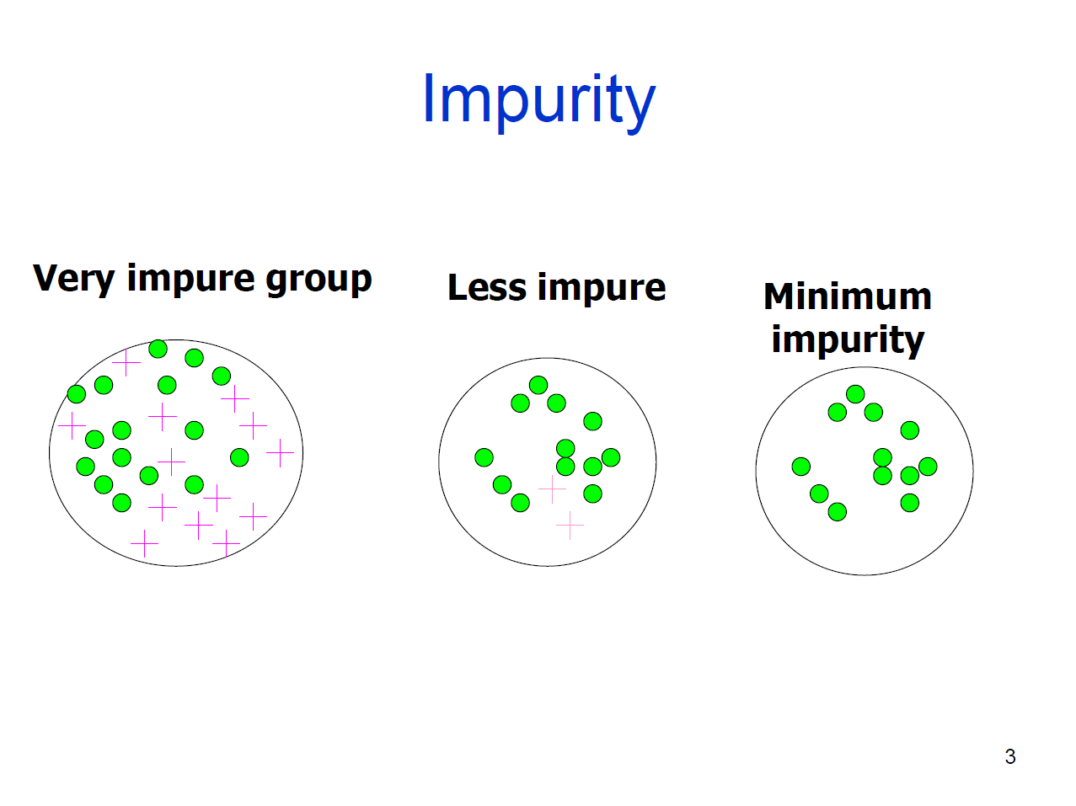

Slide 11
Other Splitting Criteria
Gini Impurity (used in CART algorithm): Gini = 1 - Σ p_i².
Mean Squared Error (MSE) for regression: Measures variance.
Lower Gini means better splits.
Different criteria suit different tasks.

Slide 12
Decision Tree: Pros & Cons
✅ Easy to understand & interpret.
✅ Handles both numerical & categorical data.
✅ No feature scaling needed.
✅ Fast training & prediction.
❌ Prone to overfitting (deep trees).
❌ Sensitive to noisy data.
❌ Biased splits if classes are imbalanced.
❌ Non-optimal global structure (greedy split decisions).

Slide 13
Random Forest: Intuition
An ensemble learning method that builds multiple decision trees.
Uses bagging (Bootstrap Aggregating) for training.
Each tree trains on a random subset of the data.
Feature randomness ensures diversity among trees.
Final prediction is obtained via majority voting (classification) or averaging (regression).

Slide 14
Random Forest: Mathematical Formulation
Bootstrapping (Sampling with Replacement) to create training subsets.
Given a dataset D with N samples, create B bootstrap datasets $D_{B}$​ where each is sampled from D
Each tree is trained on a different subset of data consists of N samples, that randomly sampled with equal prob of $\frac{1}{N}$
Changes of never being sampled: ${\left(1−\frac{1}{N}\right)}^{N}$ when $N$ is large enough ${\left(1−\frac{1}{N}\right)}^{N}≈e^{−1}≈0.368$

Slide 15
Feature randomness
Feature randomness
Avoid overfitting on one feature

Slide 16
Formula for classification: ŷ $= argmax_{k} Σ I(T_{b}(x) = k).$
Formula for regression: ŷ = (1/B) Σ $T_{b}(x)$
.

Slide 17
Random Forest: Pros & Cons
✅ Robust to overfitting - reduces variance.
✅ Handles high-dimensional data well.
✅ Captures non-linearity in data.
✅ Can handle missing values.
✅ Can be parallelized for efficiency.
❌ Less interpretable than a single decision tree.
❌ Computationally expensive for large datasets.
❌ Memory-intensive due to multiple trees.
❌ May not be optimal for small datasets.

